Slide 1
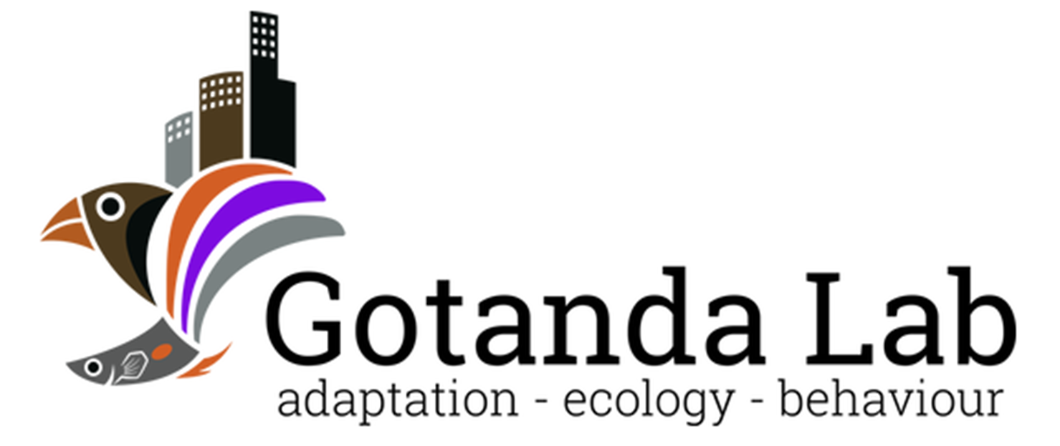

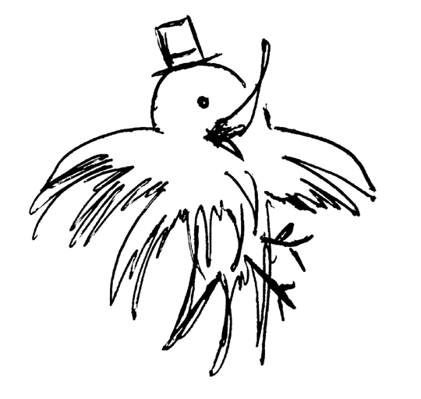
Sentinel Behaviour and Urban Environments:
A Corvid’s Perspective
Alex Popescu
Brock University

Slide 2
An important trade-off
A careful balance between two essential needs must be maintained
Eat
Not be eaten

Slide 3


An important trade-off
Two mutually exclusive requirements; too much of either is unfit
Foraging
Vigilance
↑ Safety
↑ Risk of starvation
↑ Satiation
↑ Risk of predation

Slide 4
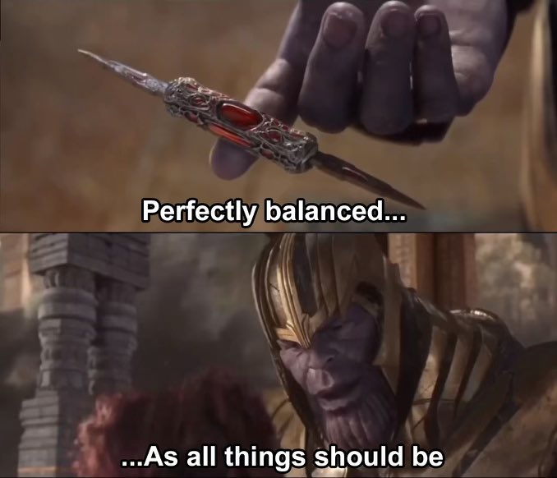
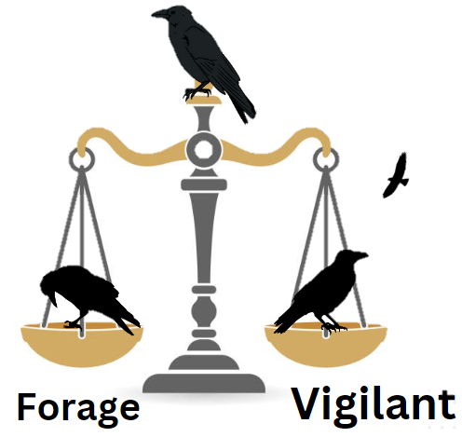
Finding the balance
A difficult task that depends on:
Intrinsic factors
Extrinsic factors
Certain species have behaviours that facilitate this task

Slide 5

Social behaviours
Social behaviours can reduce individual vigilance and increase foraging efficiency without reducing safety
↑ Complexity
Sentinel behaviour
Group foraging

Slide 6


Sentinel behaviour
A form of coordinated vigilance:
- Individuals take turns being vigilant over other group members.
- Can result in increased safety and foraging efficiency in foragers.
- Sentinel loses foraging opportunities.
Lost foraging opportunity
Why do sentinels perform the behaviour if it is costly?
↑ Foraging efficiency
↓ Predation risk

Slide 7

Selfless or selfish?
Sentinel behaviour was originally thought to be a selfless behaviour.
↑ Foraging efficiency
↓ Predation risk
Lost foraging opportunity
Sentinel
Forage
Costs of sentinel behaviour compensated by the actions of other sentinels.

Slide 8





Selfless or selfish?
More recently, empirical studies support the selfish, state-dependent model for sentinel behaviour.
Sentinel present
Sentinel Absent
Decision to perform sentinel behaviour dependent on individual’s energetic state & need for safety.
Lost foraging opportunity
↑ Risk
Earlier threat detection

Slide 9
Decisions, decisions…
The decision to perform sentinel behaviour could therefore be affected by factors both intrinsic and extrinsic.
Sentinel present
Sentinel Absent
Understanding the effects and interactions between these factors can provide insights into the decision-making of similar behaviours.
Lost foraging opportunity
↑ Risk
Earlier threat detection

Slide 10
Thesis Objectives
Throughout my thesis, I sought to answer two big questions:
How can intrinsic and extrinsic factors affect sentinel decision-making?
How does the presence of a sentinel and the foraging environment affect vigilance in an urban sentinel-using species, the American crow (Corvus brachyrhynchos)?
To do so, I performed a scoping review (Ch. 2), and an empirical study (Ch. 3), respectively

Slide 11
Chapter 2: Sentinel behaviour in mammalian and avian species

Slide 12
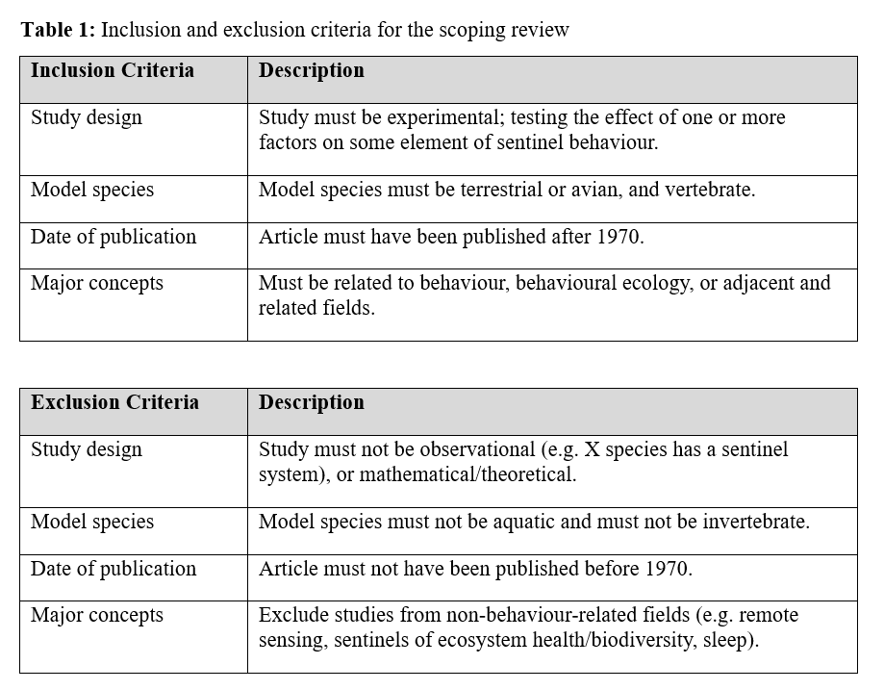
Methods
We searched Web of Sciences on Nov. 1st, 2022
- “Sentinel AND Behavio*” as keywords
- Filtered by major concepts

Slide 13
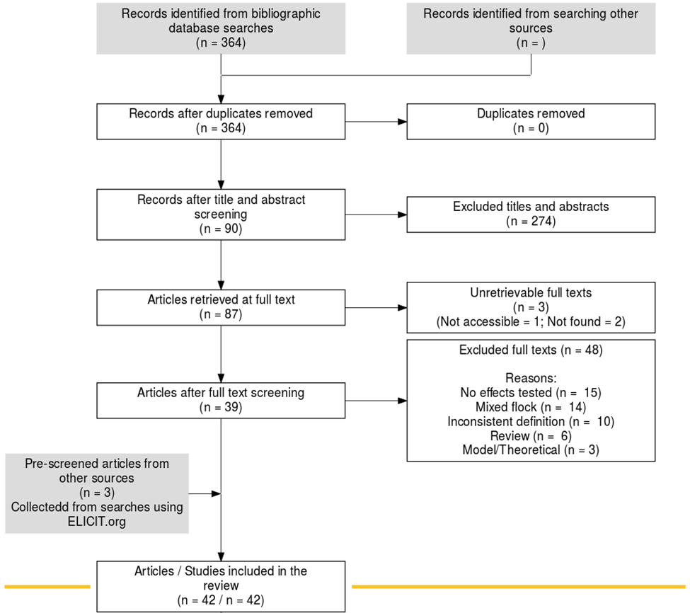
Search Results
Search string returned 364 records.
After screening, we retained 42 studies that fit our inclusion criteria.

Slide 14
Trends observed
The effects of several intrinsic and extrinsic factors were common in both mammal and avian species, including:
Intrinsic factors such as sex, body mass, and satiation
Extrinsic factors such as dominance, group size, and risk
Many intrinsic and extrinsic factors are energy-related.
An interaction between sex and dominance was often reported.
Notes:
Talk more about the implications of intrinsic and extrinsic factors

Slide 15






Energy-related factors
Sex: >
Body mass: >
Satiation: >
Group size: <
Sentinel present
Sentinel Absent
Lost foraging opportunity
↑ Risk
Earlier threat detection
Notes:
Use figures from literature to prove point

Slide 16
Risk
The greater the risk, the greater the incentive to be a sentinel.
e.g. The presence of young or of predators results in increased sentinel efforts from adult individuals.
Sentinel present
Sentinel Absent
Lost foraging opportunity
↑ Risk
Earlier threat detection
Surprisingly, the presence of outgroup rivals also increased sentinel efforts…
Notes:
Use figures from literature to prove point

Slide 17

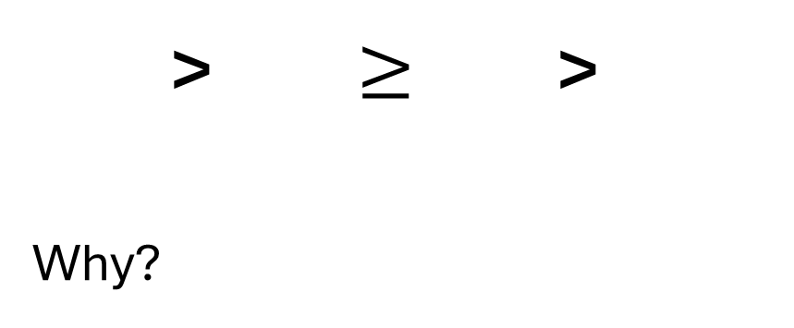
Dominance
Sentinel present
> $≥$ >
Why?
Sentinel Absent
Lost foraging opportunity
Could be energy-related but also be a result of different benefits provided by the behaviour.
↑ Risk
Earlier threat detection
Notes:
Use figures from literature to prove point

Slide 18
Non-antipredator benefits
The sentinel’s perch provides good visibility over a large area.
This could provide non-antipredator benefits to certain individuals:
Territory defense
Mate guarding
Sentinel present
Sentinel Absent
Lost foraging opportunity
↑ Risk
Earlier threat detection
Notes:
Use figures from literature to prove point

Slide 19
Chapter 2 - Conclusions
Both intrinsic and extrinsic factors could have great effects on sentinel decision-making:
Energetic availability ↑ = ↑ Sentinel behaviour
Risk ↑ = ↑ Sentinel behaviour
Habitat can affect these factors, in turn affecting sentinel behaviour (e.g. Urban vs Natural environments).
Notes:
What research remains to be done? Need to take a holistic approach as intrinsic and extrinsic factors can interact

Slide 20
Chapter 3: Heads Up! Social Vigilance Behaviour in American Crows

Slide 21
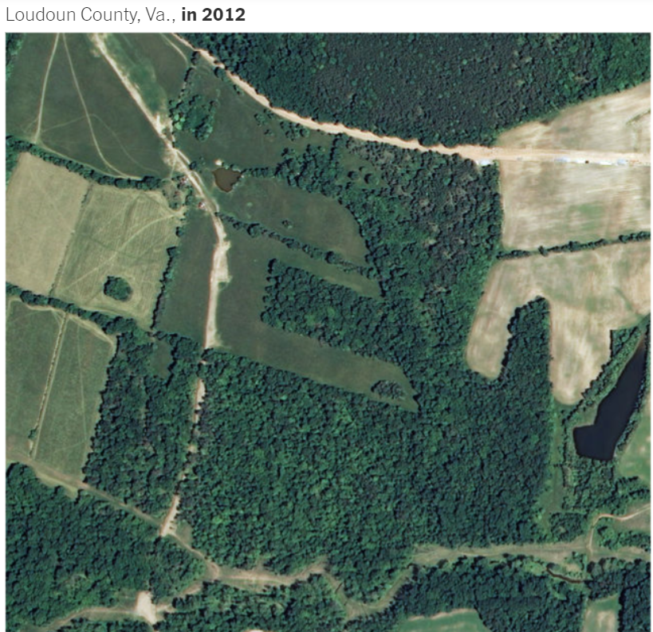
Urbanization
The shift in human population from rural to urban areas
NY Times, 2019
Notes:
~55% of world population currently concentrated in urban areas, with the UN projecting that number to climb to 68% by 2050.
Get a better image or polish it up

Slide 22
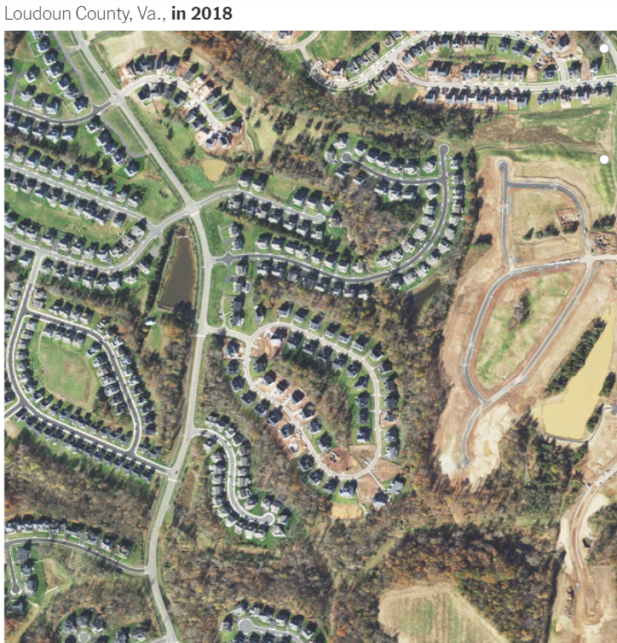
Urbanization
Leads to changes in the environment:
↓ Lines of sight
↑ Human-animal interactions
↓ Green spaces
NY Times, 2019
Notes:
~55% of world population currently concentrated in urban areas, with the UN projecting that number to climb to 68% by 2050.
Get a better image or polish it up

Slide 23
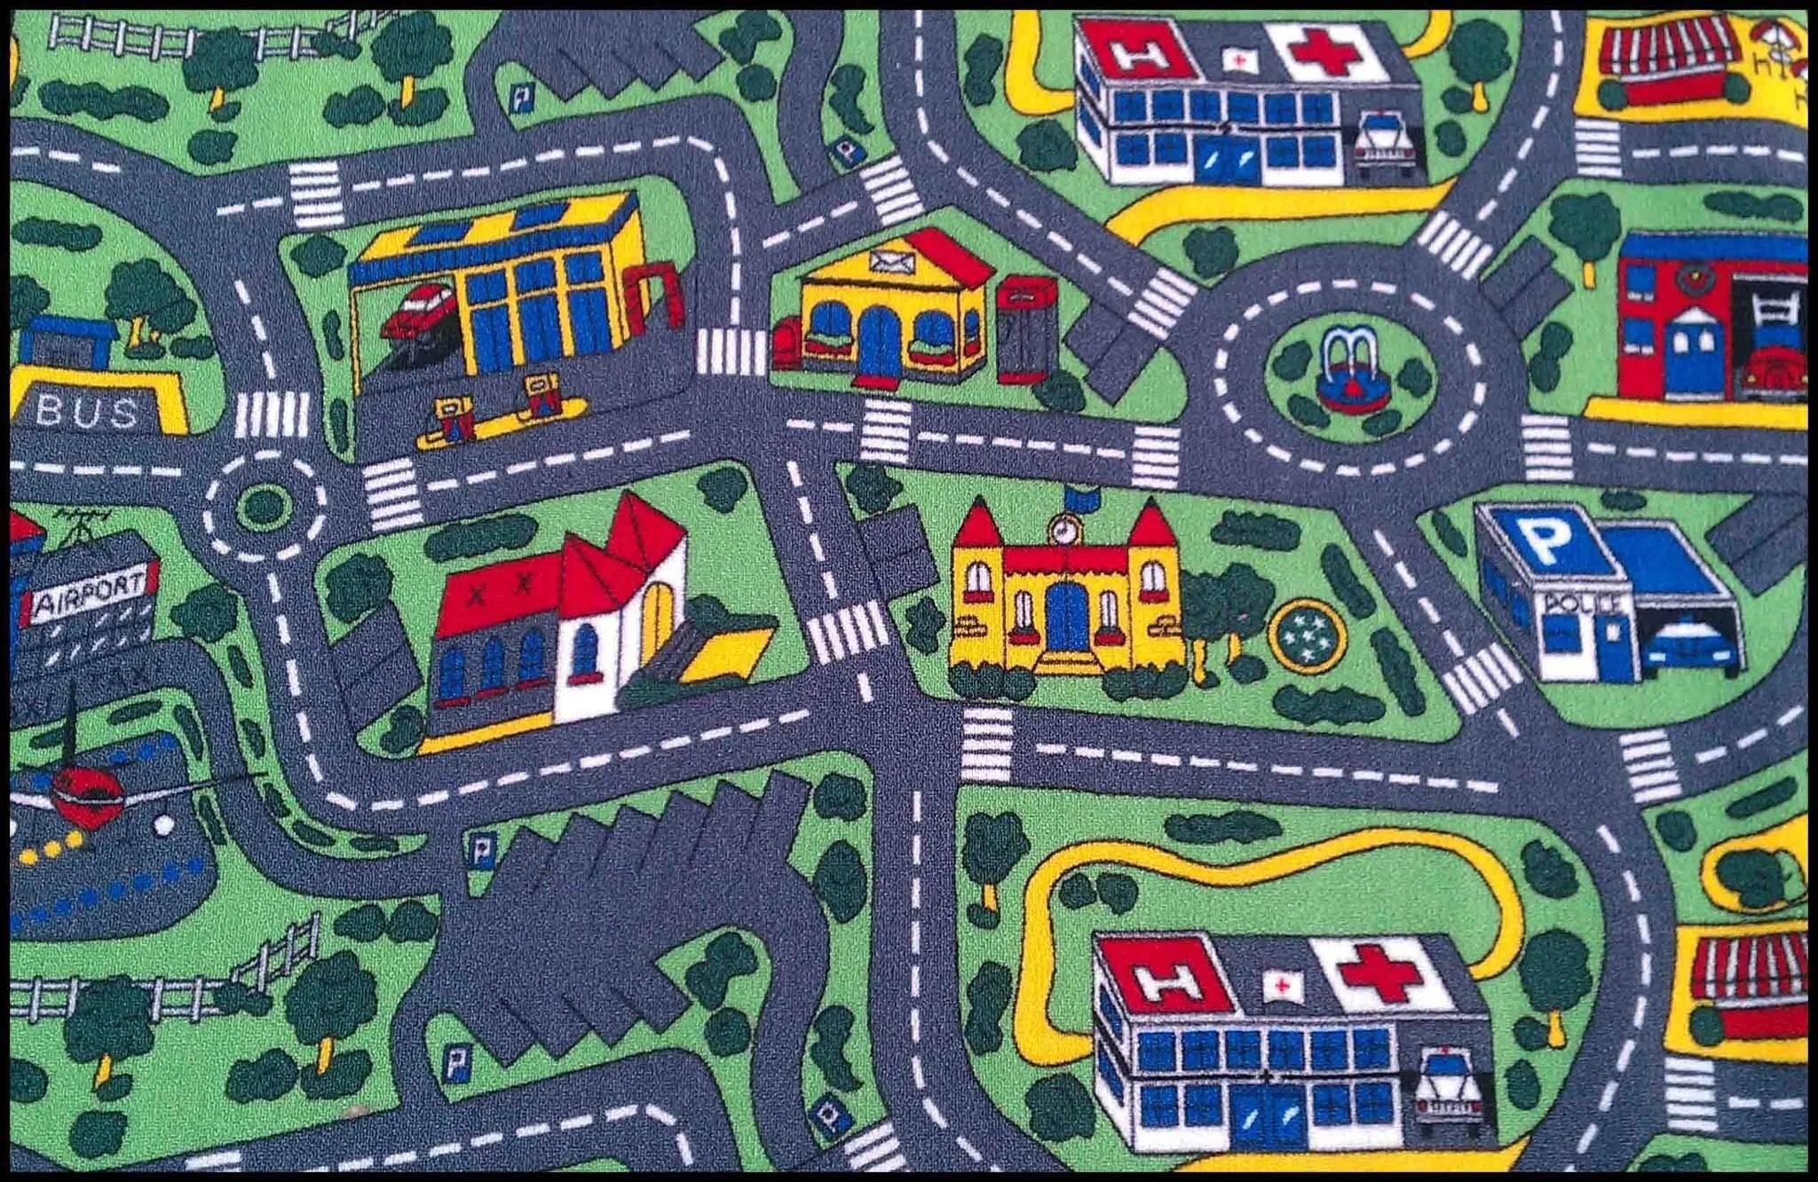
Urbanization
Urban areas are not uniform!
Has negative effects on many species; associated with the global loss of biodiversity
Kowarik I. 2011
Notes:
Better resolution image, remove url and add photo author.
You can probably remove the title in the reference

Slide 24
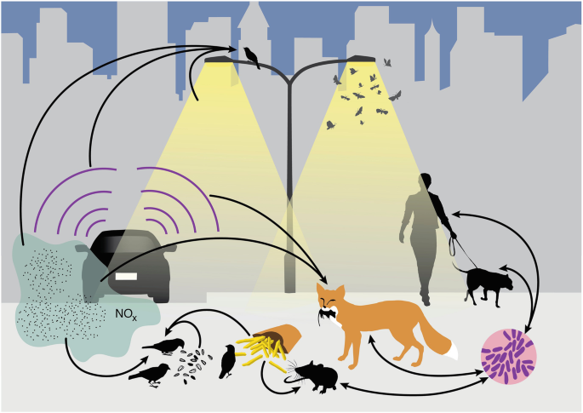
Can species be successful in cities?
Will depend on species’ traits
Advantageous traits:
Adaptability
A generalist nature
An omnivorous diet
Intelligence
Isaksson, C. (2018)
Patankar S et al. 2021
Notes:
Modified diet
↑ Interspecific aggression
↑ Tolerance of risks
↑ Tolerance of human proximity

Slide 25
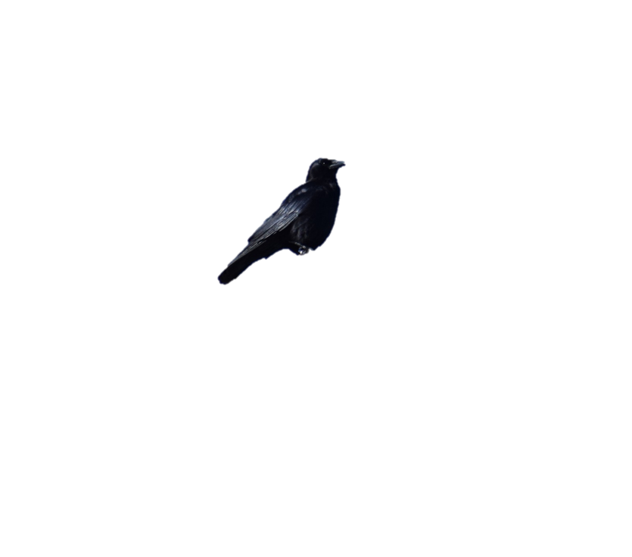
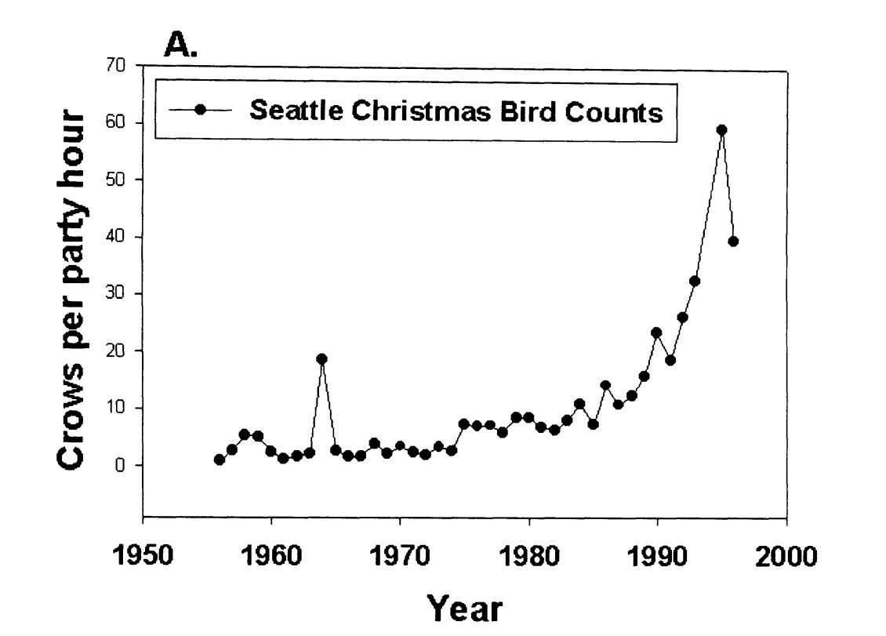
American crows in urban areas
How could the use of sentinel behaviour contribute to the success of American crows in urban areas?
Crows spotted per hour
American crow population increasing in urban areas over the last 5 decades
Marzluff et al.(2001)
Notes:
We picked the crow bc… Talk about G. env
Add caption for the image, remove the full citation

Slide 26
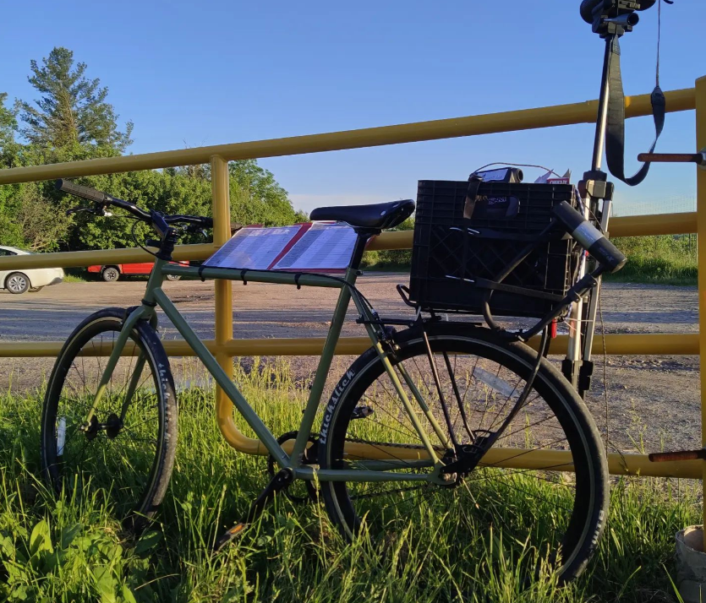
Methods
Testing sites were selected through a community science initiative: Crowkémon Go
Foraging bouts were video recorded from a distance and analyzed at a later date
Notes:
Armed with friends, cameras and bicycles, we bravely went out at 6am to chase crows!
Remove bait
Add images to explain generalized environment.

Slide 27
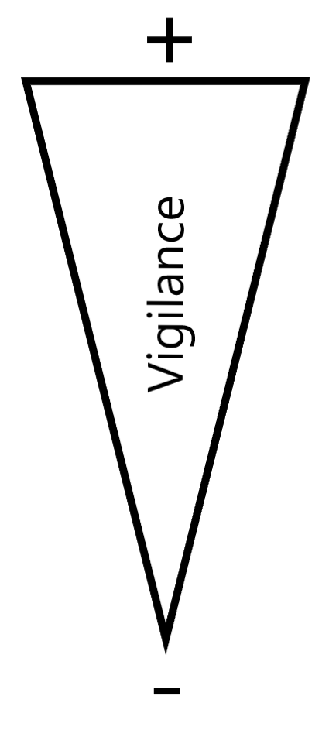

Methods
Alert
Moving
Foraging
Notes:
Can’t tell what the crow is looking at when moving (verbal)

Slide 28
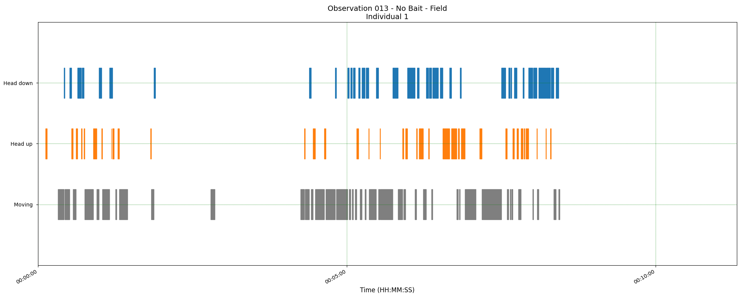
Methods
Two main measurements:
The proportion of ‘foraging time’ allocated to each behavior
Duration of behavioral instances (or bouts)
Foraging
Alert
Moving
Time
Notes:
***Briefly explain & put arrows to show what each measurement is ***
**DO NOT MENTION BORIS!!!**
Explain the measurements explicitly.

Slide 29
Research questions
 | Generalized Environment | Sentinel Presence
Allocation of time to behaviors in foragers | In green areas Foraging ↑ Alert ↓ | With a sentinel present Foraging ↑ Alert ↓
Duration of behavioral instances | In green areas Foraging ↑ Alert ↓ | With a sentinel present Foraging ↑ Alert ↓
Notes:
Remove right side, focus only on G. Env.
Be quick about it, no need to repeat, consider having the table reappear between results slides.

Slide 30
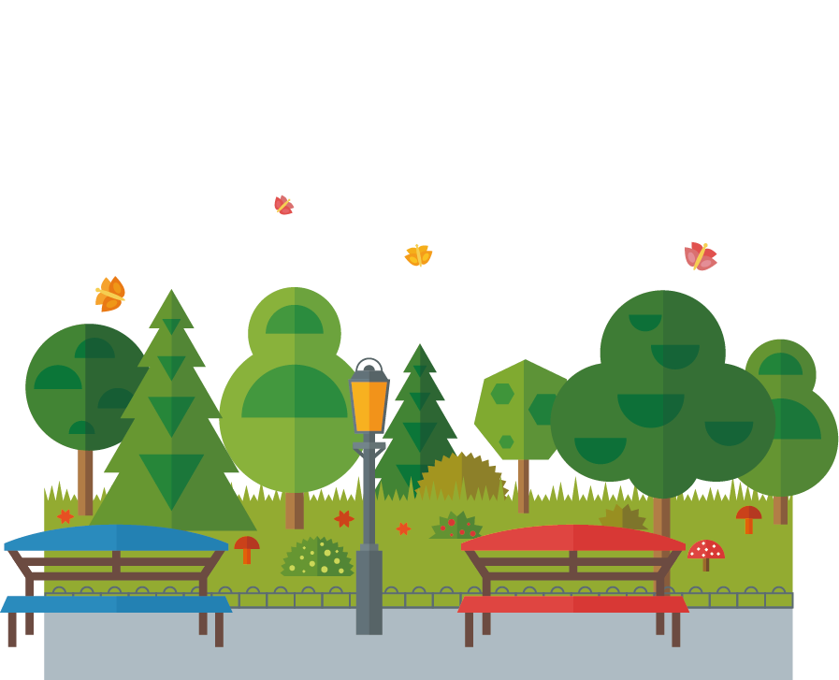

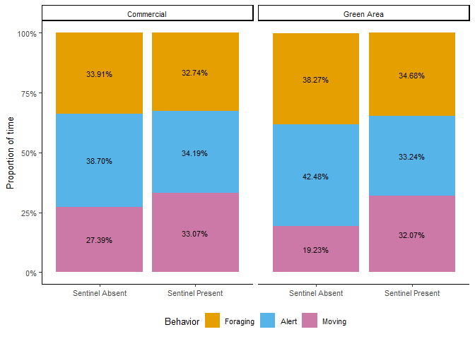

Proportion of time
Contrary to my predictions, there were no significant effects!
Proportion of foraging time
Notes:
Remove gridlines! (Go back in R, theme_classic())
Add in-between slide with thesis questions, bring it up as you answer the questions.

Slide 31
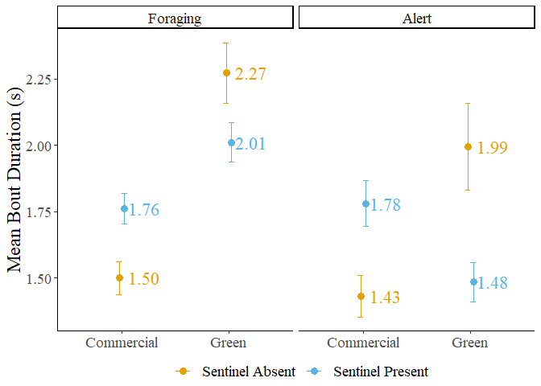
Behavioural Instance Duration
Sentinel presence did not significantly affect the duration of bouts.
Bouts of foraging behaviour were significantly longer in green areas.
No significant effects on bouts of alert behaviour.

Slide 32
Behavioural Instance Duration
Significant interaction between sentinel presence and generalized environment on both foraging and alert behaviours.

Slide 33
Generalized Environment
Food in green areas can take longer to forage on
Vegetation might obscure food – Time to find food ↑
Prey might use vegetation to escape – Time to catch food ↑
Comparatively, foraging in commercial areas could be easier
Impermeable surfaces ↑ – Time to find/catch food ↓
Anthropogenic resources ↑ – Time to find/catch food ↓

Slide 34
Generalized Environment
This could explain the shift in preference towards anthropogenic resources in urbanized species.
However, foraging on urban resources could be unhealthy
Caloric content ↑ but nutritional value ↓
Lower quality but easily accessible
Higher quality resources in green areas – Worth the risk?

Slide 36
Sentinel Presence
Benefits from sentinel coverage could depend on foraging environment.
Foragers could also be foraging in a ‘riskier’ but more efficient manner in the presence of a sentinel.
More space between individuals – Risk ↑
Foraging over a wider area – Foraging Efficiency ↑

Slide 37
Chapter 3 - Conclusions
 | Generalized Environment | Sentinel Presence
Allocation of time to behaviors in foragers | In green areas Foraging ↑ Alert ↓ | With a sentinel present Foraging ↑ Alert ↓
Duration of behavioral instances | In green areas Foraging ↑ Alert ↓ | With a sentinel present Foraging ↑ Alert ↓
No effect
No effect
In green areas
Foraging ↑
Significant interaction
Notes:
Remove right side, focus only on G. Env.
Be quick about it, no need to repeat, consider having the table reappear between results slides.

Slide 38
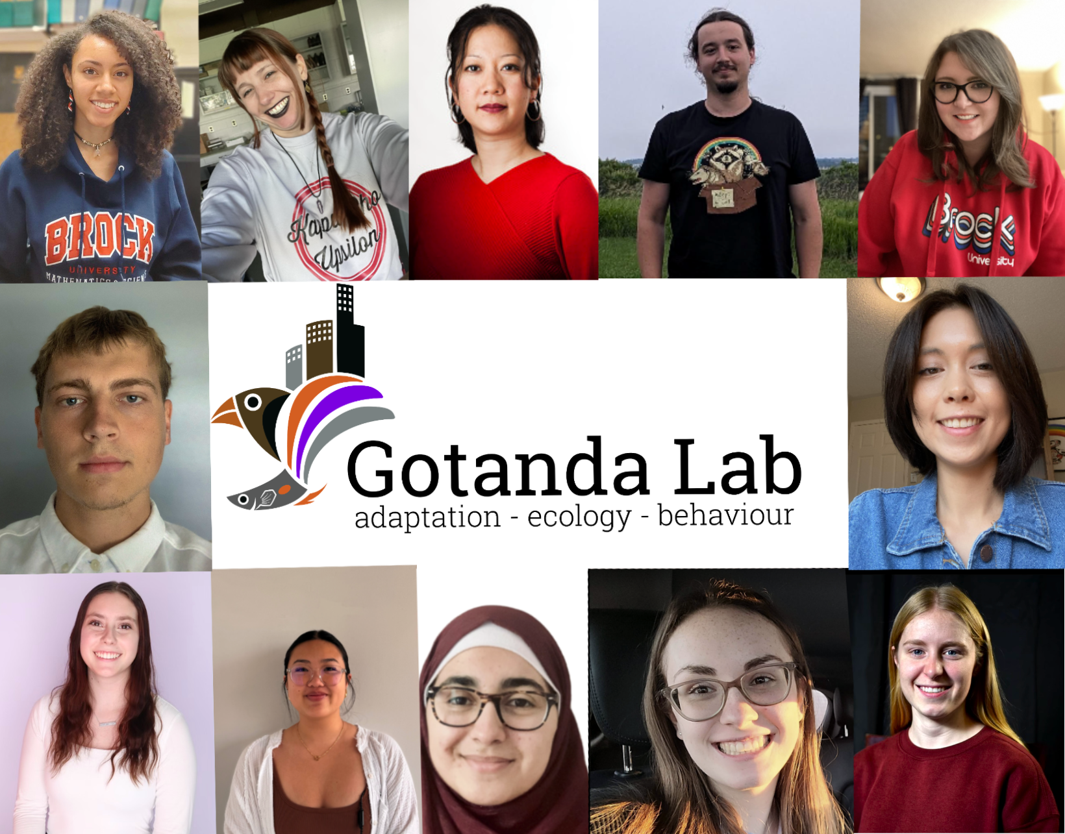
Acknowledgements
My supervisors: Dr. Kiyoko Gotanda, Dr. Liette Vasseur, Dr. Anne Clark
The Gotanda Lab
My family and friends
Notes:
Funded by Brock, no need to mention explicitly. Thank funding sources at a defense (which this isn’t)

Slide 39
Questions?

